Slide 1
Fundamental Constructs
Session Three
Notes:
Welcome to our third session! Today we’ll be talking about some important foundational concepts for coding in Python, the most important of which regards how data is stored and recalled in code.

Slide 2
Reminders
Due Today
Due Next Week
Homework from Session Two
Homework from this session
Quiz on this session’s content
Notes:
As some quick reminders before we get into things your first homework assignment is due today.

Slide 3
Reminders
Due Today
Due Next Week
Homework from Session Two
Homework from this session
Quiz on session 2 and 3 content
Notes:
Next week you’ll another homework due and a quiz which covers the material from this week and last week. So prepare carefully and be prepared for that!

Slide 4
Q&A
?
Notes:
Any questions from last week’s material?

Slide 5
Agenda / Topics
1. Start of Class Questions
2. Binary, hex, and ascii
3. Variables, objects, & Conditional Statements
4. Break
5. Security Topic
6. Overflow / Q&A / Dismissal
6:30 - 6:40
6:40 - 7:00
7:00 - 8:00
8:00 - 8:15
8:15 - 8:45
8:45 - 9:00
Notes:
Today we’ll have a q&a to answer any last-minute burning questions from last week and then we’ll be doing the practice quiz. After that, we’ll start the lecture. We’ll cover a handful of topics with a break at 8 pm and then we will get into our security topic for the week.

Slide 6
Binary, Hex, and ASCII
Notes:
Last week a few different terms came up which we hadn’t introduced so I want to take a few moments to introduce them now: binary, hexadecimal (or hex), and ASCII.

Slide 7
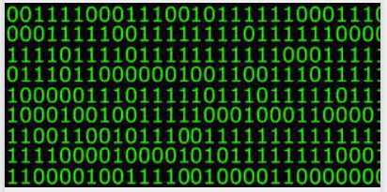
Computers and binary
Computers only “speak” one language:
Binary!
Notes:
I am going to start by explaining binary because it will help us understand what it means to have a numery system with a different base then the one we are used to which is 10.
Computers only “speak” one language “Binary!” This means that all code, no matter what language it is written in ultimately gets converted into binary so the computer can interpret it. Why is that? Well, computers only operate on 0s and 1s. Why? Well there are many reasons but a few of the most important are:
1. It is simple. And simple tends to be more efficient.
2. It is standardized.
3. Binary works nicely at the intersection of hardware and software. This is because a "0" represents no flow of electricity, and "1" represents electricity being allowed to flow.
We don’t need to know any more detail than that about why binary is used in computer but we do need to know how to recognize and interpret binary.
Computers, of course, need to be able to use the 0s and 1s of binary to store complex large numbers and eventually those numbers need to be able to represent letters and images and all sorts of complex things so we are going to explain binary then get to hex and finally to ASCII which is how computers interact with letters.
So, what is binary?
Binary is a base 2 numery system. If you heard the term “base” and got lost don’t worry, we actually all understand this concept we likely just weren’t taught it in these terms. The decimal system we are accustomed to is also called base 10.

Slide 8
Base 10
Has 10 digits: 0, 1, 2, 3, 4, 5, 6, 7, 8, 9
 | Millions | Hundred Thousands | Ten Thousands | Thousands | Hundreds | Tens | Ones
Exponent | 10⁶ | 10⁵ | 10⁴ | 10³ | 10² | 10¹ | 10⁰
Value | 1000000 | 100000 | 10000 | 1000 | 100 | 10 | 1
Number | 0 | 0 | 0 | 1 | 1 | 1 | 1
Number | 6 | 7 | 8 | 9 | 4 | 0 | 0
Notes:
In base-10, each digit of a number can have an integer value ranging from 0 to 9 (10 possibilities) depending on its position. The places or positions of the numbers are based on powers of 10. Each number position is 10 times the value to the right of it, hence the term base-10. Exceeding the number 9 in a position initiates counting in the next highest position.
We all have learned numbers in base 10 our whole lives so this comes intuitively. We know that 1111 means 1 one thousand, 1 one hundred, 1 ten, and 1 single unit. And even more complex numbers like 6 million 7 hundred 89 thousands four hundred feel really intuitive to us.
But we were not born understanding base 10 we learned it as children by using those little cubes which came in individual blocks (1), a column of 10, and a square of 100.
Because we did these exercises as kids we all know that 20 is 10 times the value of 2 and 30 is ten times the value of 3; this demonstrates that in base 10 each number position is 10 times the value to its right. Similarly, thinking about this from the opposite direction (right to left) we are all familiar with the idea of carrying a number over to the column to the left when we are doing addition and the number exceeds lets say 9 in the ones column.

Slide 9
Base 2 aka binary
Has 2 digits: 0, 1
Exponent | 2⁷ | 2⁶ | 2⁵ | 2⁴ | 2³ | 2² | 2¹ | 2⁰
Value | 128 | 64 | 32 | 16 | 8 | 4 | 2 | 1
Binary | 0 | 0 | 0 | 0 | 1 | 1 | 1 | 1
Values | 0 | 0 | 0 | 0 | 8 | 4 | 2 | 1
8 + 4 + 2 + 1 = 15 (in base 10)
Notes:
In base-2 instead of there being 10 possibilities for each digit there are 2. The places or positions of the numbers are based on powers of 2. This means that each number position is 2 times the value of the digit to the right of it. So reading from right to left we start at 1 and increase by powers of 2 each time. So whereas in base-10 we would know that 20 is 10 times greater than 2. When we look at a number in binary we multiply by 2 as opposed to 10. This means that one one (11) is two times greater than 1.
So, looking at the example on the slide, this means that 1111 is not one thousand one hundred and eleven in binary like it is in decimal. It is 8 plus 4 plus 2 plus one which equals 15.

Slide 10
Base 2 aka binary
Has 2 digits: 0, 1
Exponent | 2⁷ | 2⁶ | 2⁵ | 2⁴ | 2³ | 2² | 2¹ | 2⁰
Value | 128 | 64 | 32 | 16 | 8 | 4 | 2 | 1
Binary | 0 | 1 | 1 | 0 | 1 | 0 | 0 | 0
Values | 0 | 64 | 32 | 0 | 8 | 0 | 0 | 0
64 + 32 + 8 = 104 (in base 10)
Notes:
Looking at a table such as this can help to visualize the binary digit values and to see that when read right to left they increase by powers of two. But to know which decimal value a binary number equates to you must understand both how to interpret the 0s and 1s.
Since binary only has two possible interpretations 0 and 1, off or on. This same logic applies to how you tally the value represented by a binary number. If there is a 0 then you do not include the value from that unit into the total binary tally. Looking at the above example and reading right to left if the first digit is a 0 then we do not count a 1 into our tally, same goes for the second digit there’s a 0 which means we don’t count a 2 into our tally. In fact the first 1 we see is the 4th digit this means that we are at the 2**3 or 8. Carrying through with this same mental math we see that ultimately the only 1s are in the 8th, 32nd, and 64th places, Meaning that the value of this binary is 104.
Okay so that’s a lot of detail. How is it relevant to python? Well, we have to keep moving up, if you will, further away from the hardware and closer to the software and more human readable languages like python. So stick with me.

Slide 11
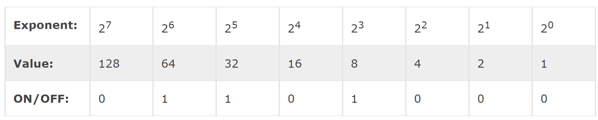
Bits, Bytes, and Binary!
Bits are the letters of binary language and bytes are words.
Bit = 1
Byte = 8 bits
The 0s and 1s are, of course, the binary.
Byte
Bit
Notes:
[Lauren] We move from understanding binary into understanding bits and bytes. A bit is simply a binary digit. Bits are the smallest increment of data stored on a computer. A byte consists of 8 bits. One of the reasons the 8 bit unit, aka the byte, is so fundamental in computer science is because a byte contains enough information to store a single letter character. This is how we start to move from 0s and 1s up to letters and ultimately to pictures and beyond!
As you can see on the slide 01101000 is a byte worth of data and any one of those digits is a bit.

Slide 12
Base 16 aka Hexadecimal aka HEX
Has 16 digits: 0, 1, 2, 3, 4, 5, 6, 7, 8, 9, A, B, C, D, E, F
10, 11, 12, 13, 14, 15
Exponent | 16⁷ | 16⁶ | 16⁵ | 16⁴ | 16³ | 16² | 16¹ | 16⁰
Value | 268435456 | 16777216 | 1048576 | 65536 | 4096 | 256 | 16 | 1
Hex | 0 | 0 | 0 | 0 | A | 2 | E | 8
Values | 0 | 0 | 0 | 0 | 40,960 | 512 | 224 | 8
(4096 x 10) + (256 x 2) + (16 x 14) + (1 x 8) = 41,704
40,960 + 512 + 224 + 8 = 41,704 (in base 10)
Notes:
Hexadecimal, more commonly called hex, is base 16 and this means that there are 16 digits in this numery system. We can use the same first 10 as base 10 (0, 1, 2, 3, 4, 5, 6, 7, 8, 9) but then we run out of numbers which wouldn’t rely on base 10 to continue incrementing up. Therefore, we need to introduce some new characters for the remaining 6 so a convention was chosen which was to use the first 6 letters of the alphabet: A, B, C, D, E, F.
If this is blowing your brain I get it but remember numbers and letters are just squiggles of ink on a paper which represent something. We know to associate A with the letter and sound A. But in hex if you see A then you know that is the base 10 equivalent of 10 and B is 11, and C is 12.
So hex is going to enable us to represent much larger base 10 numbers in fewer hex characters. For example A2E8 is hex. To figure out the base 10 equivalent we know we have an 8 in the 1s column so that’s 8. Then we have an E in the sixteenths column. E is 14 in base ten so we do 14 times 16 and get 224. Then we have a 2 in the 256ths column so we do 2 times 256. Then we have an A in the next column and A is 10 so we do 10 times 4096. We add all of those up and get 41,704. So we know that A2E8 in hex is the base ten equivalent of 41, 704. A2E8 takes fewer characters to represent the same large number and so you can imagine how if you are doing something which requires really really big numbers it could make sense to use Hex.
I am no math wiz and so, truth told, if I needed to convert from hex to base 10 I would google it and use a hex to base 10 converter. You will not need to do this math in this class or likely ever in your life. However, you are going to see hex in this line of work and you actually have already seen hex before in your life most likely.

Slide 13
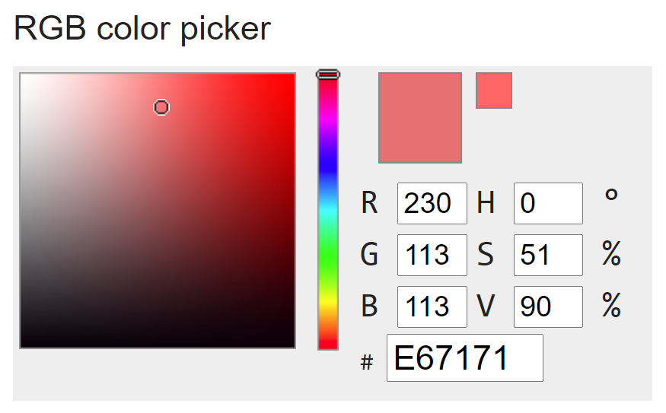
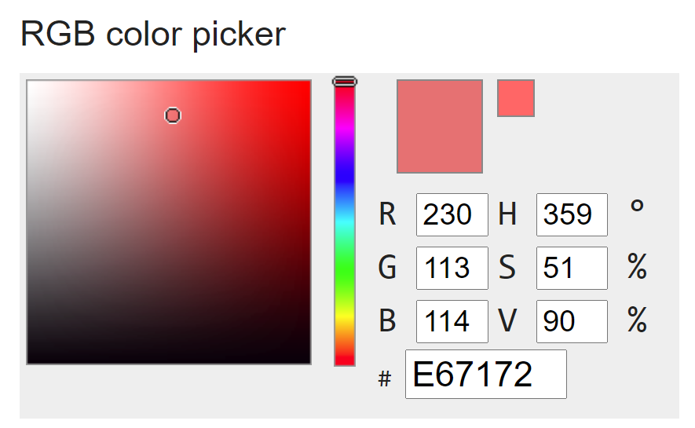
Hex in the Wild
Notes:
Colors (also called RGB color model) require lots of numbers to keep track of all of them because there is an infinite number of colors out there in the world. Therefore, it is helpful to use hex to categorize colors and hex is the standard convention for referencing colors to computers.
You should now be able to spot the hex on this slide. It’s the E67171 and the E67172. Of course to the human eye these two colors will look identical but there is some tiny shade of difference between the two of them which means they are actually distinct colors and we know this because the hex is one digit different between the two.

Slide 14
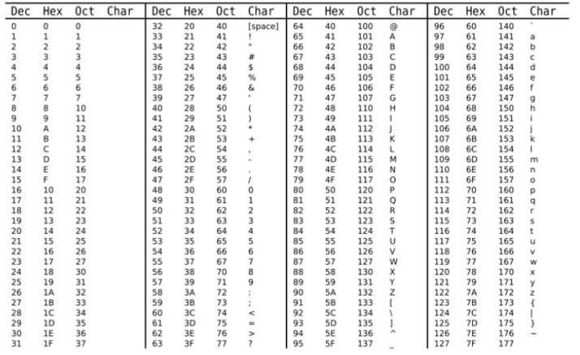
ASCII
Notes:
[Lauren] We have arrived all the way up the chain from binary to hex and now we are going to get into ASCII which is how computers convert from alphanumeric symbols down to binary to the computer. ASCII, the abbreviation of American Standard Code for Information Interchange, is a character encoding standard for electronic communication. ASCII codes represent text in computers. ASCII maps an alphanumeric symbol to a decimal number and from a decimal number, inherently, to binary! So, when you type “Hi!” into your computer or cell phone what you are actually saving or sending is 72 105 33 in decimal.
There is no need to memorize the ASCII mappings between alphanumeric symbols, decimal values, and binary. Although, it doesn’t hurt to know that capital letters range from decimal value 65 through 90 and lower case letters range from 97 through 122. It is also relevant to know that ASCII values in the alphabet count upwards meaning that capital A will be 65 and capital Z is 90. If you check the ascii value of a letter (which Python can and will do if you try to do comparison operations between letters!), letters closer to A are lower than those closer to Z.
However, in a typical work environment you can always google an ASCII conversion table. It is relevant to know what ASCII is because now we start to understand how when we type in alphanumeric code in any language it will get converted to the device to produce a given result.

Slide 15
Objects and Variables
Notes:
Last session, we learned that all of the data you’re working with in Python will be stored in objects, and that each object has a type. The type defines what properties an object has and what can be done with it. We also learned about two different types of data that represent numbers - integers and floating point numbers.
Today we’re going to learn more about how you can store and retrieve data when you’re programming with the use of what is called a variable.

Slide 16
Variable Assignment (AKA Creation, Instantiation)
The statement | my_variable = 1 + 1
Breakdown | my_variable (any variable name) | = (assignment operator) | 2 (an object, in this case an integer)
Any computation to the right of the assignment operator is computed before assignment.
If your chosen variable name (my_variable) does not exist, the program will create a new variable and store the value in it.
If the chosen variable name already exists, the value will replace whatever was there before.
This will happen even if the original variable had a different type.
Notes:
When you go to your Python interpreter and you type and enter ‘1+1’, Python will display to you the result, 2, but after that computation is run, it just stops. If we want to do anything meaningful with the result of our data - let’s say, compare it to another value or send it to a friend in a message or use it in some new bitcoin scheme or whatever it is we’re doing with code, we will need a way to refer back to that computational result.
In order to do so, we store that object in memory and we create a name by which to refer to it. Then, when we need Python to do another operation with that data, we have a name to reference it. Data stored in this way with a name is called a variable (and the name you give it is the variable name).
This concept is similar to but just a little different from how it’s used in math. They are similar in that variable names do stand in for or represent information as they do in mathematics - but they are different in that sometimes in math variable names represent unknown or undetermined quantities (e.g. “solve for x”). In Python, variables are always known objects and you as the programmer must specify which names stand in for which values (“let x be 6”). At no point in time will you have a variable that does not have a type and an inspectable value.
So, how do we do this? How do we store our value in memory and create a variable name so that we can refer back to it?
To create a variable, we use the assignment operator, which is a single equals sign. A single equals sign in Python tells the language that the name on the left hand side of the operator should be a variable name and the value on the right-hand side of the operator should be the value stored in that variable. It can also be a computational statement that will be evaluated first and the result will be stored in the variable name on the left-hand side. That’s what’s happening here; 1+1 is evaluated first and then assignment takes place.
Looking at the code on the slide you can see that we are creating a variable name of “my_variable” and we are setting that equal to the result of 1 + 1. Once we run this code - note, not type it, but run it (by pressing play or shift enter) - Python will create a variable called “my_variable” and will store in it the integer two. Any time thereafter that we refer to my_variable, Python will retrieve the object under that name (in this case, two) and substitute that value in the computation.
Let’s test this.

Slide 17
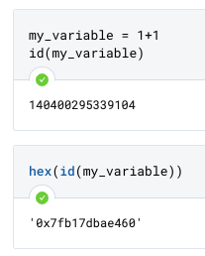
Memory
data...
data...
2
my_variable
'0x7fb17dbae460'
data...
data...

Slide 18
REferencing Variables
The statement | my_variable = 1 + 1
Breakdown | my_variable (any variable name) | = (assignment operator) | 2 (an object, in this case an integer)
The statement | another_variable = 3 + 1
Breakdown | another_variable (any variable name) | = (assignment operator) | 4 (an object, in this case an integer)
The statement | combo_variable = my_variable + another_variable
Breakdown | combo_variable (any variable name) | = (assignment operator) | 6 (an object, in this case an integer)
Notes:
If we run the three statements on the slide we will:
First statement:
Have Python compute the result of 1+1 (two);
Create a variable called my_variable and store the result of that computation in my_variable;
Second statement:
Have Python compute the result of 3 + 1 (four);
Create a variable called another_variable and store the result of that computation in another_variable;
Third statement:
Have Python compute the result of my_variable plus another_variable which means it will compute 2 + 4 (six);
Create a variable called combo_variable and store the result of that computation in combo_variable
As you can start to imagine the ability to store data in a variable enables lots of complex operations.

Slide 19
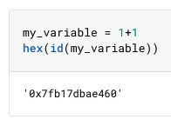
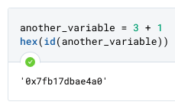
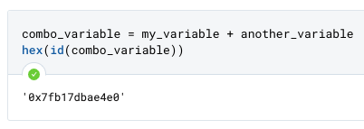
Memory
data...
data...
2
my_variable
'0x7fb17dbae460'
4...
another_variable
‘0x7fb17dbae4a0’
6...
combo_variable
‘0x7fb17dbae4a0’

Slide 20
Modifying variables
The statement | my_variable = 1 + 1
Breakdown | my_variable (any variable name) | = (assignment operator) | 2 (an object, in this case an integer)
The statement | my_variable = my_variable + 1
Breakdown | my_variable (any variable name) | = (assignment operator) | 3 (an object, in this case an integer)
Notes:
If we run our original statement first and then add a second statement as shown above and then run them together, we will:
First statement:
Have Python compute the result of 1+1 (two);
Create a variable called my_variable and store the result of that computation in my_variable;
Second statement:
Compute the result of my_variable (currently storing the integer two) + 1 (three);
Store the result in the variable my_variable (which will replace the previously stored value with the new result, making it now the integer three.
It is important to practice with the type of examples on this slide and to learn that you can essentially write over a variable and assign it a new value as we have done here where my_variable was initially 2 but becomes 3 when we run the second statement and write over the initial value stored there.
We can chain these kinds of statements together to do many different types of operations. In a moment, we’ll cover many of the available mathematical operators. But, first, let’s zoom in on the variable naming bit.

Slide 21
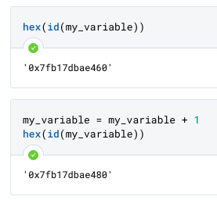
Memory
data...
data...
2
'0x7fb17dbae460'
my_variable
data...
...

Slide 22
Memory
data...
data...
2
'0x7fb17dbae460'
my_variable
3
'0x7fb17dbae480'
...

Slide 23
Assigning one variable to another
The statement | my_variable = 1 + 1
Breakdown | my_variable (any variable name) | = (assignment operator) | 2 (an object, in this case an integer)
The statement | new_variable = my_variable
Breakdown | my_variable (any variable name) | = (assignment operator) | 2 (an object, in this case an integer)
Notes:
Here’s a fun question. What do you think Python does if you assign a variable to another variable?

Slide 24
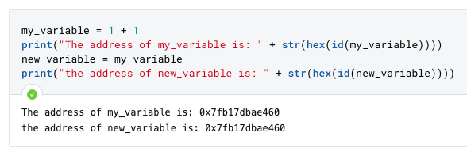
Memory
data...
data...
my_variable
2
'0x7fb17dbae460'
new_variable
data...
...

Slide 25
Changing Variables
The statement | my_variable = 1 + 1
Breakdown | my_variable (any variable name) | = (assignment operator) | 2 (an object, in this case an integer)
The statement | new_variable = my_variable
Breakdown | new_variable (any variable name) | = (assignment operator) | 2 (an object, in this case an integer)
The statement | my_variable = my_variable + 1
Breakdown | my_variable (any variable name) | = (assignment operator) | 3 (an object, in this case an integer)
Notes:
If we run the three statements on the slide we will:
First statement:
Have Python compute the result of 1+1 (two);
Create a variable called my_variable and store the result of that computation in my_variable;
Second statement:
Have Python compute the result of 3 + 1 (four);
Create a variable called another_variable and store the result of that computation in another_variable;
Third statement:
Have Python compute the result of my_variable plus another_variable which means it will compute 2 + 4 (six);
Create a variable called combo_variable and store the result of that computation in combo_variable
As you can start to imagine the ability to store data in a variable enables lots of complex operations.

Slide 26
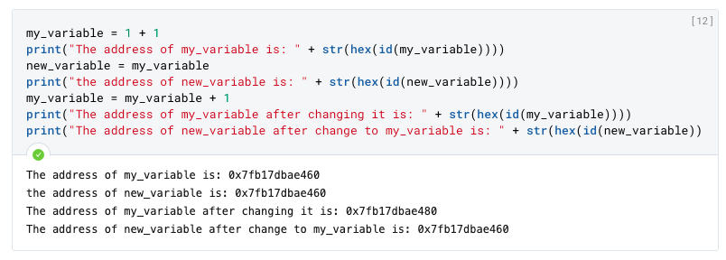
Memory
data...
data...
my_variable
2
'0x7fb17dbae460'
new_variable
3
0x7fb17dbae480
...

Slide 27
Does Type Matter?
The statement | my_variable = 1 + 1
Breakdown | my_variable (any variable name) | = (assignment operator) | 2 (an object, in this case an integer)
The statement | my_variable = float(my_variable)
Breakdown | my_variable (any variable name) | = (assignment operator) | 2.0 (an object, in this case a float)
Notes:
Here’s a fun question. What do you think Python does if you assign a variable to another variable?

Slide 28
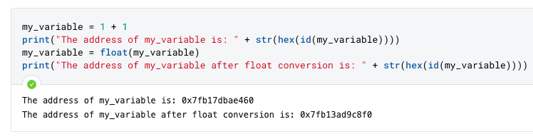
Memory
data...
2
data...
my_variable
data...
...

Slide 29
Memory
data...
2
2.0
my_variable
data...
...
Notes:
A couple of things that are important to note while we are here talking about variables: Python is dynamically typed. This means that Python will essentially determine the type of objects more or less on the fly. First, our value in my_variable was two. Right now, my_variable is the float 2.0. Python will essentially stomp the previous value and type in the background.

Slide 30
Questions on Variable Assignment So Far?

Slide 31
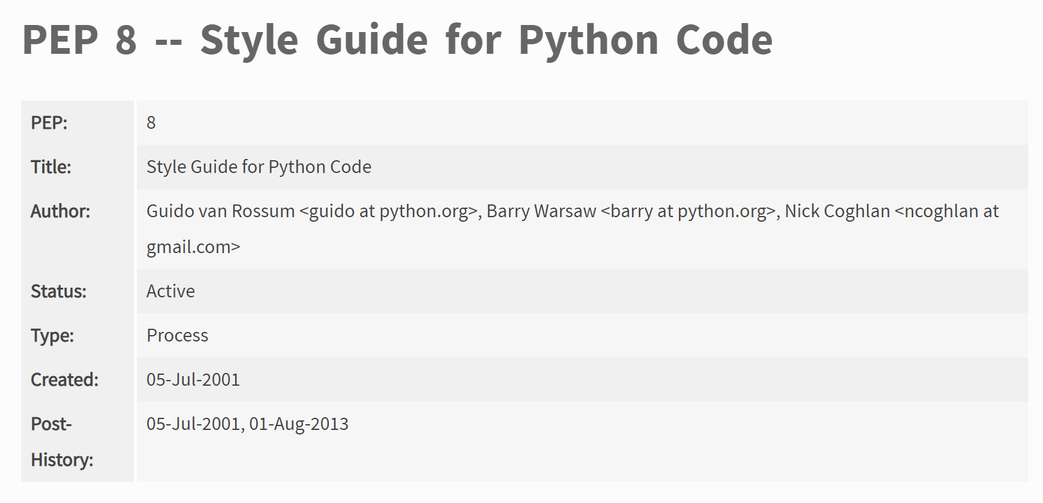
Introducing PEP 8 Remember - “Beautiful is better than ugly”
Python has a style guide and you must adhere to it when writing code.
You can find it on the python website.
It contains guidance like the information presented on the previous slide about whitespace.
Notes:
As you will recall from last class the Zen of Python is a poem of sorts which explains the design principles of python. One of them is “beautiful is better than ugly.” This aphorism helps explain why design is central to python. As such, there is a set of style guidance which is called PEP 8. You can find PEP 8 on the python website (or at the link below). PEP8 is where you find norms such as variable naming conventions and guidance on using tab or 4 spaces for whitespace.
It is advisable to use the PEP8 because it makes it easier for yourself and others to follow along with your code. Also, depending on where you work and what your role is it may be required. For this class it is required and we will deduct points from your work if you do not follow it.
https://www.python.org/dev/peps/pep-0008/

Slide 32
Variable Naming conventions
Descriptive names
single_string_of_characters, no punctuation; don’t start with a number
Never mix letter case
CONST vs regular_variable
Don’t use underscore at the start of a variable (for now!)
FREEZING_POINT = 32 # const freezing point of water in Fahrenheit
current_temp = 68
Notes:
There are some standards in Python around how variables should be named. These rules are not all enforced by the interpreter - but if you fail to follow them, then at best you will confuse fellow programmers and get some points knocked off your work and at worst you’re going to brick your program because you overwrite some core functionality in the language. So pay attention to these.
All variable names should follow the pep8 style guide (https://www.python.org/dev/peps/pep-0008/#naming-conventions). However, it is important to understand that the code will still run when it does not comport with the style guidance - it will just look goofy to anyone else who looks at your code (like us). Some of the core rules to remember are:
Variable names need to be descriptive. Make sure that someone else can read and understand what your variable names contain and how they will be used.
Variable names must be either a single string of characters and, if multiple words are contained, they should be separated by underscores. Don’t try to use other punctuation.Variables can contains numbers, but they should not start with them and to be honest this is pretty uncommon.
You should never mix letter case. Variables should either be all lowercase or uppercase letters, and each has a meaning:
If you intend for a variable that you create to never be modified by the code or another user, that variable is what is commonly referred to as a constant or a “const”. In Python, the distinction between a constant variable and any other variable is not enforced by the interpreter; there’s no way to force a variable to be unchangeable. Instead, Python has a convention that you write constant variable names in all capital letters as a way of sort of indicating a value shouldn’t change to others who might read or use your code. So, if you are, say, storing the freezing point of water as a variable - something that should never be changed because, you know, physics, then you should record it in your code in all capital letters.
Any other variable should be in all lowercase letters.
Starting a variable name with an underscore has a special meaning: these variables are not meant to be accessed by other people calling code that contains them. You will most likely never need this convention in this class - so simply don’t start your variables with underscores for now. Trailing underscores have a meaning as well - they are usually used to avoid conflicts with Python keywords. In general these are easy to avoid, so for now just don’t use reserved keywords and don’t use trailing whitespace for class. But these are fine if you are using a reserved keyword.
Speaking of which….

Slide 33
ReserveD Keywords
False | await | else | import | pass
None | break | except | in | raise
True | class | finally | is | return
and | continue | for | lambda | try
as | def | from | nonlocal | while
assert | del | global | not | with
async | elif | if | or | yield
Python has plenty of these. Here’s the most common ones.
Notes:
There are many reserved words in Python. Here are the most common ones. A reserved keyword is any word that holds significant meaning to Python.
For example, you’ll see that this list contains the phrase “import”. We used this keyword when we examined the zen of Python. “Import” is a key word that tells Python you want to reference a saved file of Python code to do something with it.
Because this word has special meaning to Python, if you try to use exactly this word as a variable name, Python is going to get very confused. You should never use a reserved keyword as a variable name, If for some reason you end up in a place where it just does not make sense to use any other word, you can put an underscore after the keyword to use it (e.g. import_). But, again, there’s almost never a time where this is the only reasonable choice.

Slide 34
Quiz: good or bad variable names
For each of the following: which name example is always bad, never bad, or depends on context?
Pi = 3.14
QUARTER_VALUE = .25
dollarsInWallet = 20
cost_of_item = 40
_number_of_items_ = 100
yield_ = 10
_profit = 80.0
Notes:
Don’t mix cap and lowercase; probably should be a CONST
Probably fine
No camelcase
Yep that’s fine!
Nope! Front underscore could be context but back one doesn’t make sense
Valid! That’s a reserved word. Better if another name could be used though
Valid if this is an internal variable name not meant to be used

Slide 35
Some additional hiccups
my_variable = your_variable = 10
my_variable, your_variable = 10, 10
my_variable = 10; your_variable = 10
These are all valid.
Semicolons separate multiple individual statements on one line
Multiple things can be assigned together using either commas or chaining multiple individual assignment statements (the value on the right is always evaluated fully before assignment)
Notes:
You won’t see these often, but just to note; semicolons can be used to show multiple individual operations on the same line of Python and you can assign multiple objects at one time by chaining them together. We covered this last week when we talked about whitespace, and this is what it looks like in-context with assignment.

Slide 36
Assignment or Equality
What’s z at the end of this sequence?
A)
x, y = 1.0 + 2, 1 + 1; z = 0
z = float(x == y)
Z
B)
x = 1; z = 2.0; y = x == z
x = x == x
z = z**int(x+1) % 3
z
Which is which

Slide 37
CONTROL FLOW:
Boolean Values (bools)
Logical Operators
Conditional Statements

Slide 38
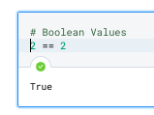
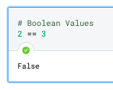
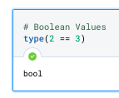
Boolean Values
True or False
Notes:
In Python, as in many other pursuits, logic uses a boolean logic system premised on the concept that logical or mathematical statements evaluate as either True or False but never both or neither.
We’ve already come across one logical operator - our equality check with ==. Comparing one value to another always produces a statement that is either true or false.
Notice how in the two examples above the returned value is either True (with a capital T) or False (with a capital F). In Python, the capitalized words True and False are reserved keywords that represent the boolean logical conditions of being either true or false.
If you print the type of the data these expressions that is returned, Python will tell you it is a bool. Bools, short for Booleans, are a Python data type that can only be True or False. Using boolean values allows for tight use of logic when running a program.

Slide 39
Data Types covered to date
Type | Examples | Properties / Description
Name: Integer (“int”) Code to convert: int(x) | -1 0 1 | Integer whole numbers that you can use in mathematical operations
Name: Floating Point (“float”) Code to convert: float(x) | -1.0 0.0 1.0 | Decimal-point precision real numbers that you can use in mathematical operations
Name: Boolean (“Bool”) Code to convert: bool() | True False | Data type that can only be True or False. Conditions exist to convert objects into True or False values.

Slide 40
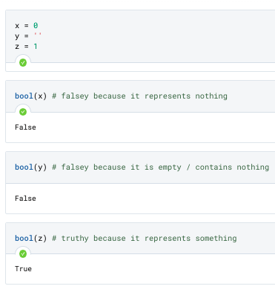
Truthy & Falsey Values
Everything can evaluate as a bool
Notes:
In addition to Bools, Python also uses a system of “truthy” and “falsy” values.
While we’ve already show an example of a comparison that results in a clear boolean response, it turns out that there are predefined rules to determine the “truthiness” or “falsiness’ of Python objects on their own independently that can also allow you to use non-boolean entities in boolean expressions. You can think of this kind of like implicit conversion. Python has its own implicit logic that it will use to make comparisons between objects if you try to compare them as if they were booleans.
The general rule of thumb that Python uses is that objects that are “falsy” are non-existent in some fashion (e.g. they are None or False), they contain nothing or contain a representation of nothing (e.g. zero as an integer or float), or they are empty (a string with no characters, a list with no objects, and so on). Most everything else is considered “truthy” just for existing.
This property allows for anything in Python to evaluate as either Truthy or Falsey to be used in logical statements. You can evaluate the Truthiness or Falseyness of something by calling bool() on the object. This will force Python to evaluate the expression or entity as a boolean and it will tell you which it evaluates to.

Slide 41
Logical Operators
Normal Operator | Bitwise Operator | Description | Syntax example
and | & | Logical AND: True if both the operands are true | x and y
or | | | Logical OR: True if either of the operands is true | x or y
not | ! | Logical NOT: True if operand is false | not x
n/a | ^ | Exclusive Or (XOR, pronounced X-OR, incorrectly “ZOR”) | ^ x
Truth tables and Python
Notes:
Now, when it comes to working with boolean expressions, we can make use of operators and conditional statements. We’ll start with operators. We’ve already seen one logical operation that returns a boolean - our double equals to check equality. What are some other logical operators we can use?
This chart shows Python’s normal logical operations - they reserved keywords and, or and not. You can use these expressions with boolean operators or statements being evaluated for truthy or falsy-ness to help direct and control what code is run and under what conditions it is run.
The last one in the table, the exclusive or, is only used as a bitwise operation. Bitwise operations are used on binary values. We won't use them often in this class, but we will likely hit them a little bit. These operators are used in the security space when dealing with malware and we also may see variations on them when we work with pandas later in the semester to manipulate data tables. So for now you mostly need to focus on the normal operators for the first three lines and we’ll return to the last one in this table after the midterm.
We’ll test out how these work in a moment, but first let’s cover one more topic - conditional statements.

Slide 42
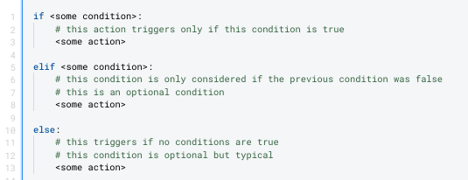
Conditional Statements
Controlling code flow.
Notes:
Conditional statements are statements that allow you to make decisions about which code is run based on the state of objects or expressions in your code. The most important keywords are if, else if (elif), and else.. Let’s walk through each individually:
If is the first keyword. This is the first word in the control flow statement, and if sets up that you are checking if a statement is true or false. If the statement is true, any code that is indented below the control flow statement will be run. If it is not, code continues on the next unindented line.
The second keyword is “elif”, short for else if. This statement allows you to write additional “if” style conditional statements that will only be run if the preceding if statement (in the same scope, that is, at the same level fo indentation here) is false.
Finally, we have “else”. Else is run last if none of the if or elif statements are true.
Let’s look at a practical example.

Slide 43
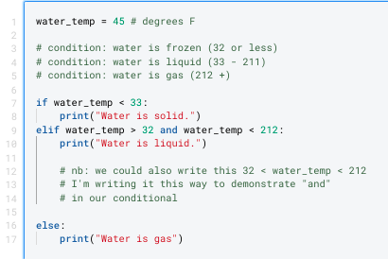
Conditional Statements
Controlling code flow.

Slide 44
Concepts to review from this session
New Data Types Fundamental Python constructs that define how data is stored and what can be done with it. | Booleans (Bools)
New Concepts Ideas, concepts, or other abstract processes for working with code. | Variables & Assignment Naming Conventions & Pep8 Reserved Keywords Multiple statements in one line Truthiness & Falsiness
New Operators Python foundational operators that take action on data. | And, Or, Not (soft intro: exclusive or aka xor) Use of : when setting off a conditional statement
New Keywords / Expressions Reserved keywords, statements, expressions, or other constructs for manipulating data. | Conditional Statements (if, elif, else)
New Functions Python’s general purpose way to call code to complete specific tasks | None
New Methods Code that belongs to specific object types that can be called on objects of the appropriate type. | None

Slide 45
BREAK
Notes:
Alright. This has been a lot of seemingly inconsequential math. Everyone is probably ready for a break. I promise the concepts we’re talking about here - the idea that data has types, certain types of operations work with certain types of data, and the concept of changing from one type to another - these will be really useful in this class. It’s a bit boring because we’re trying to start with just a couple of very simple and similar types - but hopefully you’re all hanging in there. I promise working with Python in security is exciting but we’d rather the first couple sessions are boring than completely confusing. Get a stretch, get something to drink, and we will reconvene to dive into the security topic for today.

Slide 46
Infosec
Topic
“When faced with an analytical problem, people are either unable or simply do not take the time to identify the full range of potential answers.”
Richards Heuer from
The Psychology of Intelligence Analysis
Crafting comprehensive intelligence questions
Notes:
Welcome back everyone! Last week in our Infosec topic we introduced a particular discipline within cybersecurity, that of cyber espionage and more accurately stated counter-espionage. We also started to understand the building blocks of how the internet works such that we have a basic understanding of how devices and internet connections are identified and how domains are assigned to particular IP addresses. Today we are going to dive into a critical skill to learn if you want to go into the field of counter-espionage and that is the skill of crafting comprehensive intelligence questions. Next week we will be covering intelligence writing. These two skills go hand in hand.

Slide 47
Good Intelligence Questions are answerable
Was there foreign interference in the 2016 election?
What election?
What technologies are we concerned about?
2016 US Presidential
2016 US Congressional
Social Media
Election Machines
Primary
General Election
Facebook
Twitter
Instagram
Were Facebook ads purchased by accounts which share technical infrastructure with known Russian government accounts and targeted at US audiences between April 2015 and November 2016?
Notes:
The entire point of this lecture will be to convince you that at its core what makes a good intelligence question is that it be answerable. This sounds a lot easier than it is in practice. One of the unique challenges in this field is to pose questions which are answerable using the data which is available to you.
For example let’s say you start with this question, “Was there foreign interface in the 2016 election?” This is a question that I bet every single person in this class has read about, written about, debated, etc. This would also be a terrible question for any person in this class to pose as the topic for a project they wish to take on because it is a poorly crafted question. If this were a question that you brought to me as your team lead I’d have to break that big question down into hundreds (possibly thousands) of sub questions such as:
How do we define foreign?
What countries are we interested in?
What does interference look like?
What technologies are we interested in?
There were a lot of elections in 2016 which one are you interested in in particular?
What is your threshold for determining interference?
Do you care if the interference was relevant or only if it occurred?
And that’s just a quick list.
Whether you are going to go on to a career as an intelligence analyst, manager, policy person, engineer, journalist, etc. it will be helpful to be able to ask the right questions so that you get the answer you want and don’t make unreasonable asks of your team.

Slide 48
(Priority) Intelligence Requirements
Best practices for writing a good intelligence question:
Ask a single question
Rank the questions in order of importance
Be specific
Focus on findable facts
Additional considerations:
Ensure data sources are available to you to answer the question
Continue moving deeper down the question chain until you have a question which is a reasonable size for you to answer.
Notes:
Intelligence requirements are a tool which come out of military planning and are commonly used across government analytic endeavors. Over the past 10 years they have been ported over to the private sector and are a common tool used for example by client-facing companies to ensure the work they are doing is aligned to the client’s needs and are used by teams answering complex analytical questions to ensure cohesion across a group of analysts.
The idea is that intelligence requirements are then prioritized becoming priority intelligence requirements (PIRs) and that these drive associated collection requirements (CRs). Once you have your set of questions (PIRs) you can then go about identifying data sources from which you can collect info which can then be passed off to someone for analysis to try to address the initial PIRs.

Slide 49
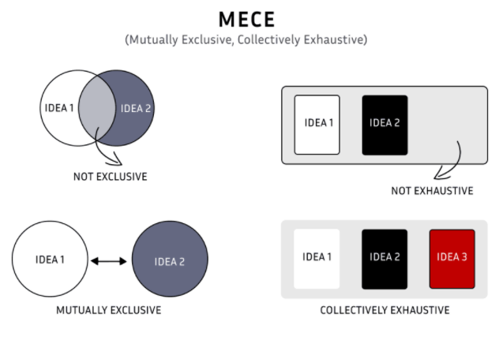
(Priority) Intelligence Requirements
Notes:
Intelligence requirements outline the questions which must be answered in order to draw a particular conclusion or make a decision. A key to writing good intelligence requirements is that they be mutually exclusive and collectively exhaustive (pronounced ME CE). The idea behind MECE is that you group components together until you can summarize them with the highest level questions which totally capture all of the questions you will need to answer while ensuring that each question is distinct so that you are not redundantly answering questions or muddying your answers by answering two questions at once.
Then once you have your high level MECE questions you break each question down into component questions until you have no more necessary questions to answer.
While in large enterprises, like the government, agencies may have thousands of detailed intel requirements and a whole team may work years on just answering one of them in this course we are each individually going to be doing our own independent work so we will need to use this tool to drive clarity of purpose without as much concern around how exhaustive they are. I have found that starting a project by writing out intelligence requirements is a good forcing function to take a structured approach to the work.

Slide 50
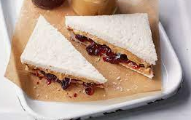
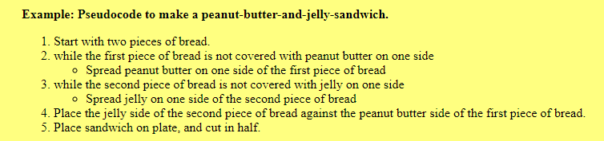
Why is taking a structured approach helpful?
Code is inherently structured!
So taking a structured approach to writing your code will save you time.
Remember the peanut butter and jelly exercise? You need to really break down each aspect of a coding approach into very tactical and explicit steps. Until you are familiar with this sort of thinking it will behoove you to write out your approach in pseudocode.
Notes:
Taking a structured approach at the outset of your projects will be extremely helpful with creating a wireframe (aka an outline) of the notebook you will develop and the code you will need to write. Until you are quite comfortable with coding in python it will likely be very challenging for you to just code and debug on the fly. This will be particularly overwhelming as you start to work with large datasets (e.g. all data on Twitter) or data which is less familiar to you (e.g. malware hashes). If at each step you have to see what results you get an plan your next line of code it will take you forever and likely lead to some bad code which wasn’t written efficiently.
Instead if you use pseudocode at the beginning of your project to outline each and every question you will need to answer with your code then you get a logical outline, identify the data sources you need, can identify gaps where you don’t know what types of code will be required to accomplish that work, get feedback, and THEN set out to write your code.
To give an example of what this might look like, I might have a question such as “How is the ISI using Facebook Groups to social engineer information out of Indian military personnel?” I might then create a code outline which says something like I want to look for the word “Spy” in the “Job” field of every person in this particular Facebook Group called “Indian Military Supporters” whose home country is listed as Pakistan or whose language is Punjabi. Then I will need some way to store the users who do in fact meet these criteria. Then I want to discard all of the other people. I then want to take the set of potential Pakistani spies and expand my search to all of their Facebook friends to identify people whose job is “Spy” language is “Punjabi” etc. I want to do this recursively until I find no more Pakistani spies. Then finally I want to take that whole set of users and see which are in Facebook groups who title includes the words “Indian military.”
There are probably a million other ways to approach this problem but this is one structured approach which I have outlined. I am sure we can all spot many possible gaps in this approach so it might be worth it to outline a couple of possible approaches and to get feedback on which will be the easiest to code or the most likely to get me an answer.
I can then highlight areas where my coding knowledge is lacking so I might say to April, “Hey how do I go about saving each set of potential spies on each run and then read it back in to get their friend group?” She might then say “Oh, you are going to have to learn about this python thing called pickling which can help you with that. Go read up on it and lmk if I can help you write the code.”

Slide 51
Intelligence Questions
How is commercially developed malware being used to target dissidents?
Is TikTok a major amplifier of COVID misinfo?
What was the hackers’ intent when they stole 70 million AT&T customers user records?
Who is targeting Georgetown University students with phishing emails?
Notes:
In more structured environments such as the government, consulting, or product companies you might interact with PIRs and CRs. However, in your own work it is totally reasonable to think about these a bit more simply as intelligence questions. You can be a bit more lax about not needing to outline every possible question and sub question because you won’t be let’s say allocating millions of dollars towards answering a given question. However, you do want to ensure that you have considered multiple approaches and that the question you are answering is tactical enough to get the data you need, write the code you know how to write, and answer the question you have posed.
Please choose one of the four questions above and start sharing into the chat how you would break the question down into better intelligence questions which would support answering the higher level question.

Slide 52
Q&A
Reminders:
Sign up for office hours on Canvas
Homework should be in your email already
Quiz next week, review document in email
Recommend reading in email

